Slide 1


Addressing Connectivity Challenges of Disparate Data Sources in Smart Manufacturing
Smart Manufacturing Pavilion
Meet the Experts Stage
Alan Weber – September 19, 2019

Slide 2
Outline
Problem statement
Gigafactory context
Smart Manufacturing data sources
  Unifying concepts
  Characteristics
  Challenges
Example solution architectures
Questions

Slide 3

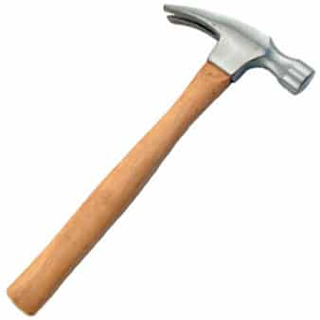
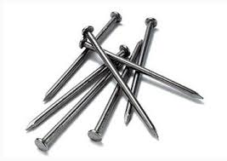
Problem statement
Background
  Data collection is the principal enabling technology for maintaining a Smart Factory’s “digital twin”
  The diversity of data sources in Smart Manufacturing environments is growing, not shrinking
Goals
  Access important information in these data sources with minimal custom software
  Leverage existing data collection infrastructure to seamlessly integrate data from all sources

Slide 4
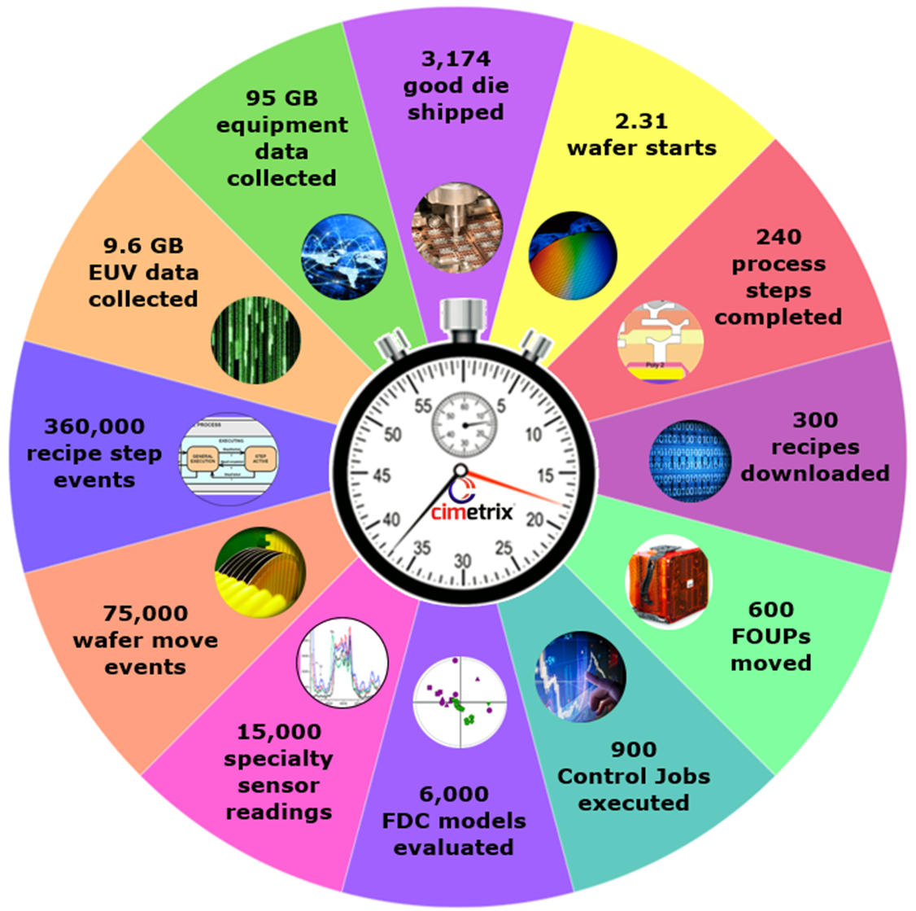
Gigafactory context
In every minute of every day…
EDA services collect millions of parameters…
GEM messages coordinate hundreds of transactions…
GEM300 events track thousands of activities…
Copyright © 2019 Cimetrix. All Rights Reserved.

Slide 5
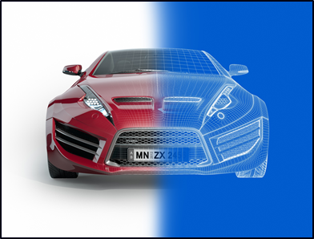
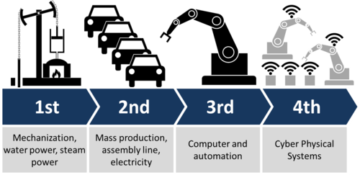
What is “Smart Manufacturing?”
From Industry 4.0 Wikipedia…
“… cyber-physical systems monitor physical processes, create a virtual copy of the physical world and make decentralized decisions.
Over the Internet of Things, cyber-physical systems communicate and cooperate with each other and with humans in real time…”

Slide 6
Outline
Problem statement
Gigafactory context
Smart Manufacturing data sources
  Unifying concepts
  Characteristics
  Challenges
Example solution architectures
Questions

Slide 7



Semiconductor Smart Manufacturing
Data sources (current sampling…)
SEMI Standards-compliant interfaces
  EDA/Interface A
  SECS/GEM/GEM300
Custom interfaces
  Purpose-specific (EUV data collection)
  External sensors (RGA, OES, …)
  Equipment log files (many examples)
OPC-enabled equipment/subsystems
  OPC Classic DA (Data Acquisition)
  OPC UA (Unified Architecture)
IIoT…

Slide 8
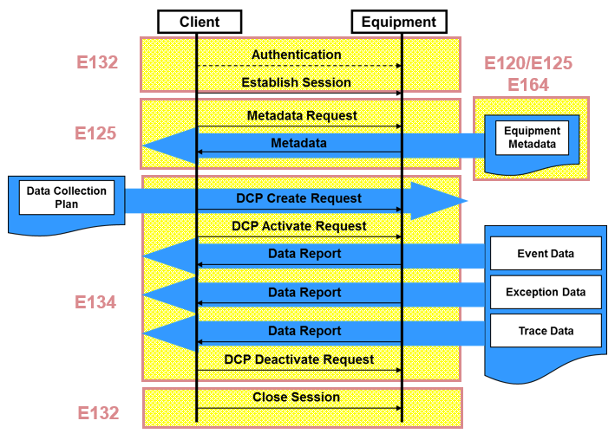
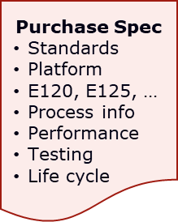
Issues with SEMI EDA data sources
Equipment models are vendor specific
Models may or may not reflect equipment structure, depending on when they were defined
Models may not provide sufficient visibility into equipment behavior
Interface performance may not match expectations if control system was not redesigned
All of this is improving rapidly as fabs take a more prescriptive approach to their automation specs

Slide 9
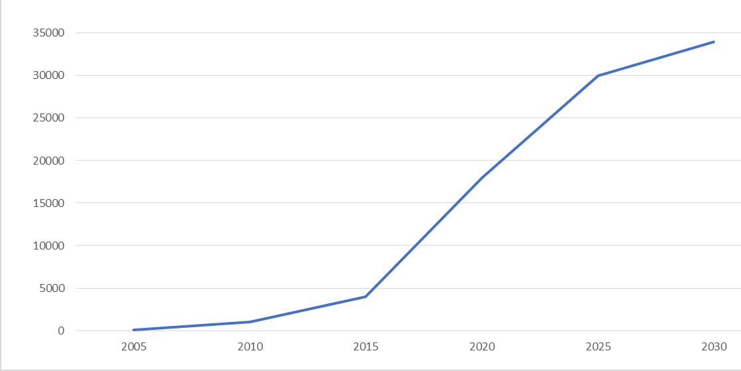









EDA adoption status
Cumulative # of production tools installed
All are now requiring latest SEMI Standards for
equipment modeling and data acquisition
Principal Motivation: Flexibility…
Data collection plan
Changing requirements
Multi-client architecture
We are here !

Slide 10

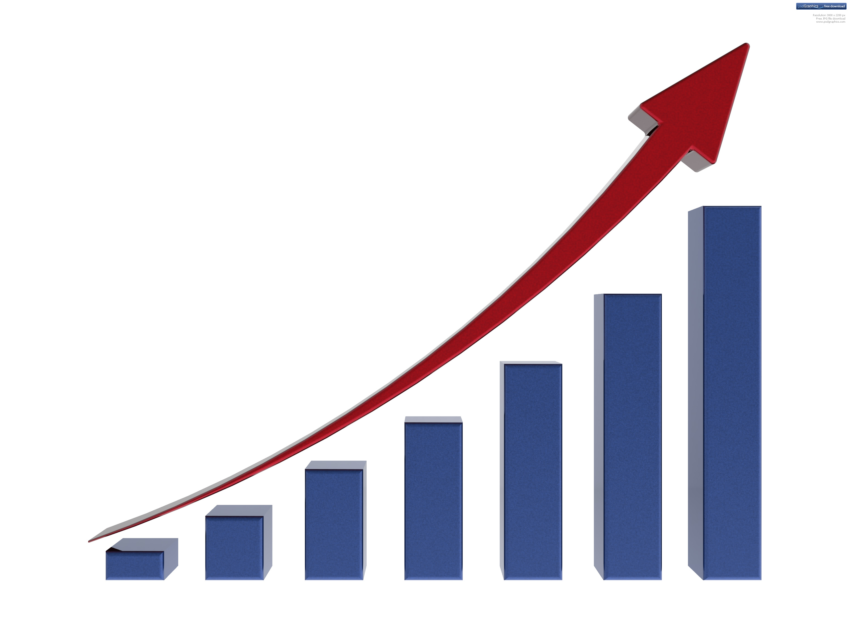
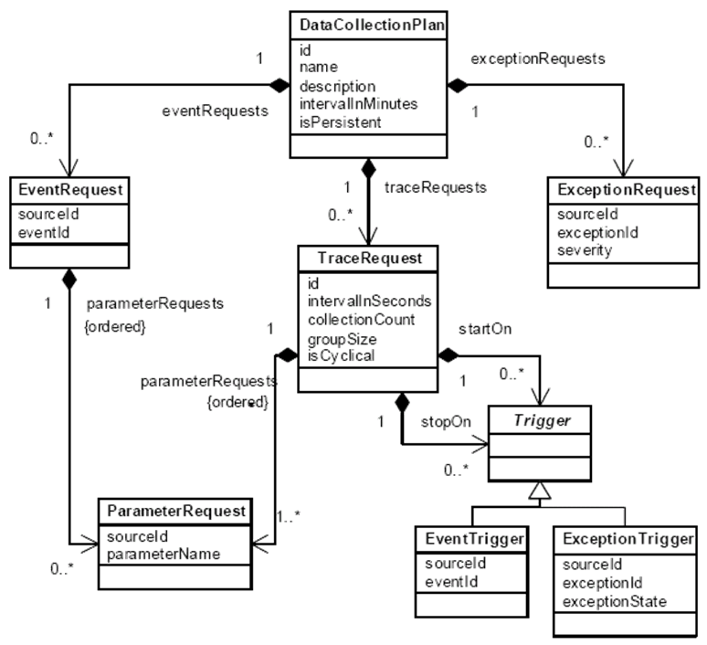

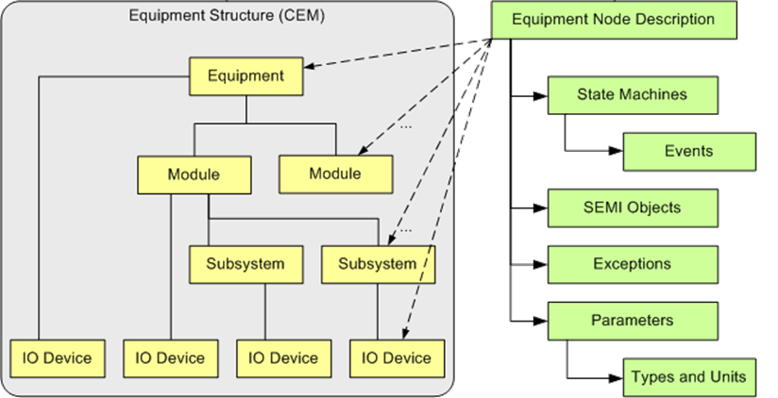

Unifying concepts/relationships
Generalizable from SEMI EDA standards
Manufacturing
Stakeholders
and their KPIs
Data
Collection
Plans
Equipment
Data
Consumers
Equipment
Model
Data

Slide 11
Unifying concepts
Metadata model and data collection plan (DCP)

Slide 12
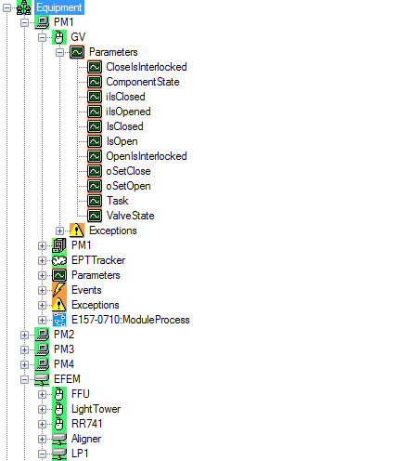
Shared equipment model benefits
Driven by factory requirements…
Structure exactly reflects equipment hardware organization
Provides complete description of all useful information in the equipment
Always accurate and available – no additional documentation required*
Common point of reference across all factory and supplier stakeholders
Source of unambiguous information for database configuration
Reduces integration engineering
Process Module #1
Gate Valve Data
Substrate Location
Utilization
More Data, Events, Alarms
Process Tracking
Other Components
* As long as it can be queried from the equipment

Slide 13
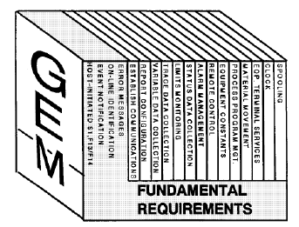
Issues with SEMI GEM data sources
Equipment model is not explicit
GEM/GEM300 will persist as the principal “command and control” interface
Data collection mechanisms are fixed and limited
  Event reporting
  Trace reporting
  Variable status queries
Equipment “model” must be derived from lists of variables, events, constants, state machines, etc.
  The recent SEMI E172 standard (SECS Equipment Data Dictionary) offers a partial solution
  But must be specified if it is to be delivered

Slide 14
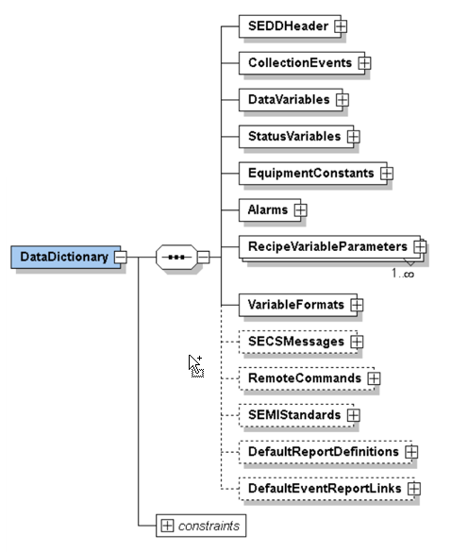
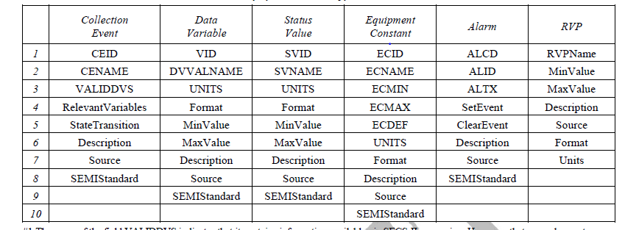
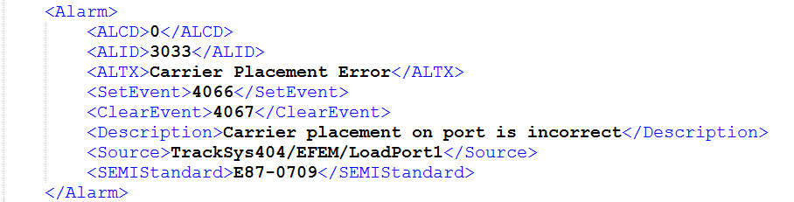
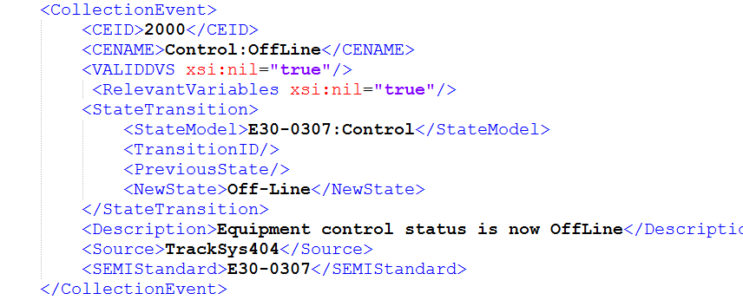
SEDD – SECS Equipment Data Dictionary
Schema and examples
….

Slide 15
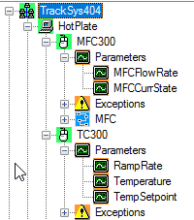
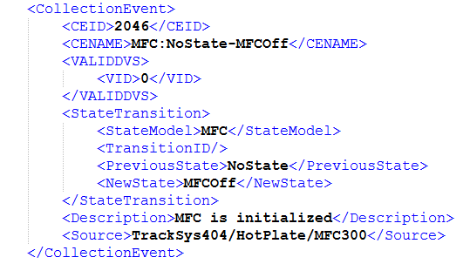
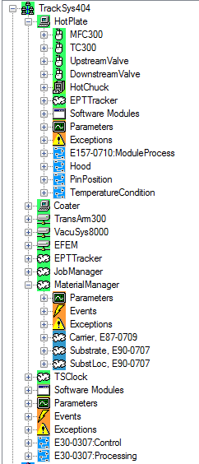
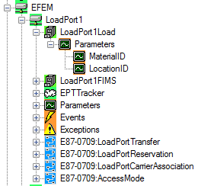
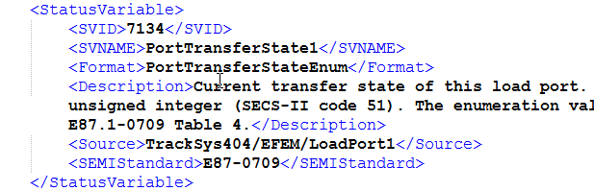
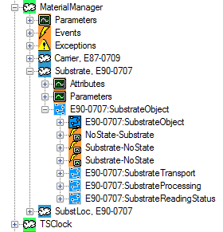
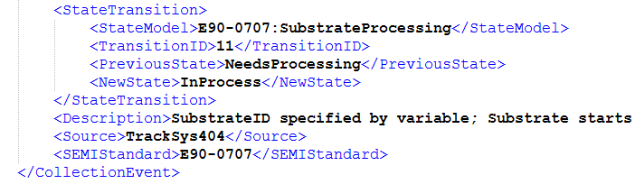
GEM equipment model structure
Embedded in E172 (SEDD) <source> elements

Slide 16
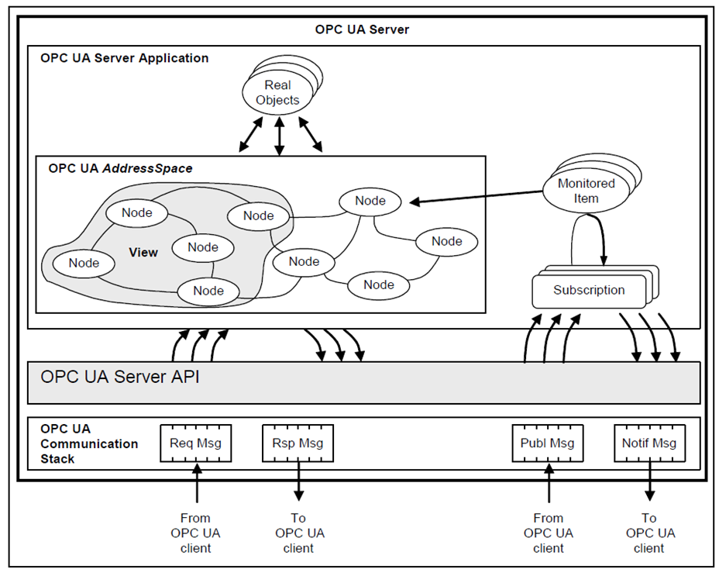
Issues with OPC UA data sources
OPC UA is an architecture, not a standard
Set of architectural specifications for creating integrated factory systems
Systems include manufacturing equipment, applications, data repositories, and the other components that interconnect them all
Interoperability of the system components depends on their respective suppliers having chosen compatible and similarly scoped profiles
Because of the breadth of OPC UA’s applicability and variety of implementation options, this itself is a significant system engineering task

Slide 17
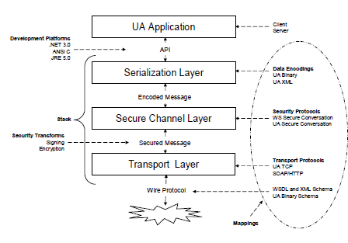
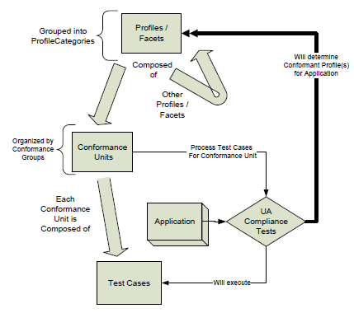
Interoperability of OPC UA components
Requires compatible “mappings” and “profiles”
Figure 1 – The OPC UA Stack Overview
(from Volume 6)
Figure 1 – Profile – Conformance Unit – Test Cases
(from Volume 7)

Slide 18
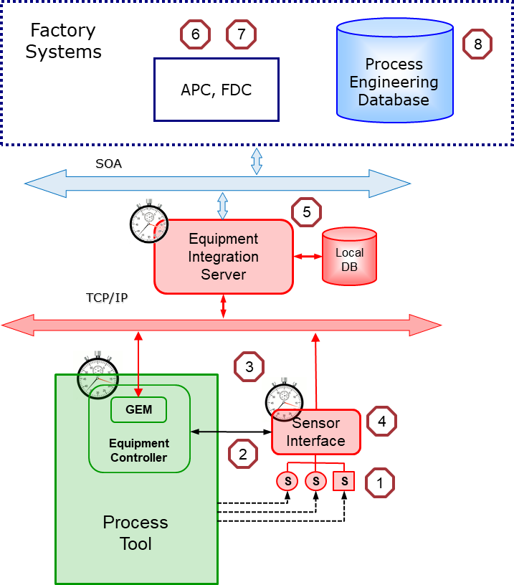
Issues with external sensors
Implementations are factory specific
Typical challenges….
Finding a sensor that works
Sampling/process synchronization
Dealing with multiple timestamps
Scaling and units conversion
Applying factory naming convention
Associating context and sensor data
Ensuring statistical validity
Aligning results in process database

Slide 19
Outline
Problem statement
Gigafactory context
Smart Manufacturing data sources
  Unifying concepts
  Characteristics
  Challenges
Example solution architectures
Questions

Slide 20
Example solution architecture
EDA-based sensor integration
To factory-level systems
FICS / MES
Process-specific
applications
Factory-level
EDA Client Apps
(DOE, FDC, PHM, …)
OEM Tool
Process
Engineering
Database
GEM
EDA
EDA Client
HTTP
HTTP
HTTP
EDA Client
Raw Data
Metadata Model
Public
Data
Smart
Data
Model
Pump I/F
TP
EDA Server
* DCIM =
Data Collection
Interface Module
Context data
Synchronization data
DCIM*
DCIM
Custom
or
EtherCAT
Proprietary
Applications
Sensor/Actuator Gateway
TCP/IP
Device Drivers
Synchronization signals
TP
DP
A
S1
S2
S3

Slide 21

Issues with equipment log files
Their formats are custom designs
Optimized for ease of creation
  NOT consumption
Type of information included varies
  Mixture of events, parameters, alarms
  Mixture of critical data and “just in case” stuff
  Parameter values often stored in native, binary form
Format may change throughout the log
  Not just a simple set of identical records
  Multiple sections, headers, record layouts, even files

Slide 22

Issues with equipment log files
They disappear over time
Usually circular file system
  Fixed limits for file sizes and number
  When limits are reached, oldest files are overwritten
Retention period may vary with activity
  And available storage space

Slide 23



Issues with equipment log files
They reside on the tool
Part of the local file/directory system
  Access methods dictated by platform technology
  Special permissions may be required to keep from invalidating tool warranty
They depend on the tool’s clock
  So the timestamps are almost always wrong…
  May be able to correct reports if offset from factory reference clock is tracked continuously

Slide 24




Example solution architecture
Equipment Log File Processing
XML/Text
Model
Editor
Data Source
Models
(1 per tool type)
Data Source
Model Validator
DataSourceModel
.xsd
(schema)
elastic
Filebeat
Data Collection Plan
SEMI E134 .wsdl
(schema)
Process
Data
Repository
(Historian)
Equipment
Control Platform
Log
Files
elastic
logstash
EDA
NewData Reports
Factory
EDA Client
Software
EDA
Server
Log File Processor
Trace data
Event data
Context data
Isolates
Custom
content

Slide 25
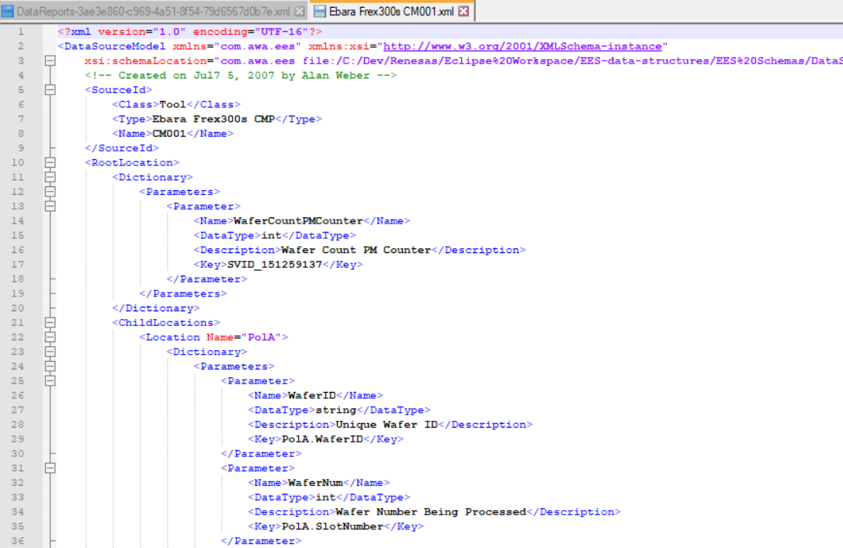
Key system components
Data Source Model (DSM)
Foundation for entire system architecture
  Could be derived from EDA equipment metadata model
Identifies type/name of the system that generated log file
  E.g., process equipment, supplier, tool type, model name, etc.
Maps contents of custom log file into standard tool data reports using unique “keys” for items of interest
  Keys are assigned in the log file parser
  Keys appear in correct equipment structural context in the DSM, resulting in proper sourceId (location) and parameterName
Includes optional elements for
  Data type declaration: necessary for subsequent report processing
  Units conversion: raw binary to scaled engineering units
  Event augmentation: generate enumerated state values

Slide 26
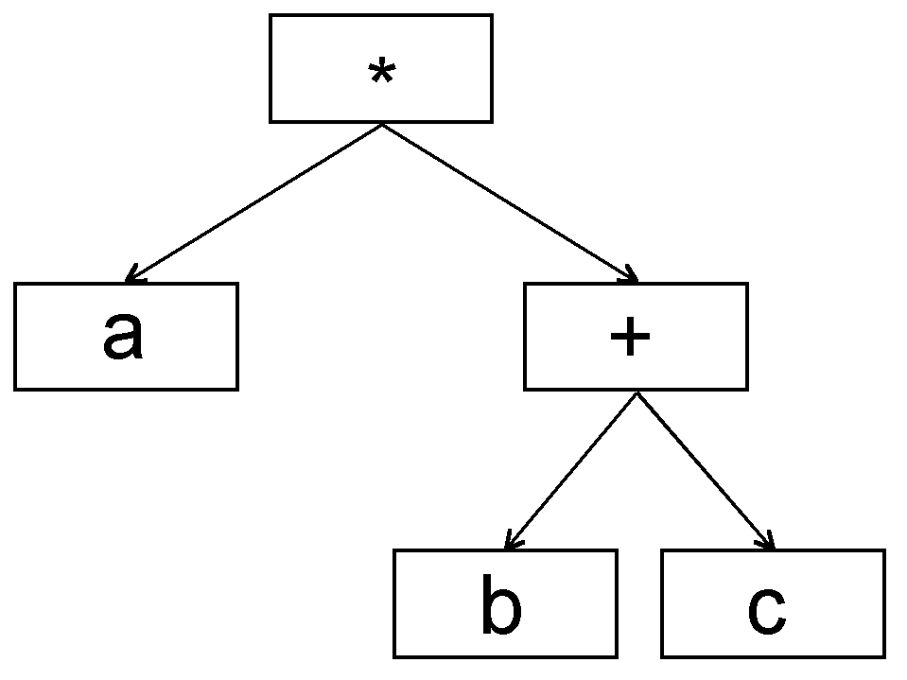
Key system components
Data source parser
This is where most of the NRE (non-recurring engineering effort) will be spent
Some of this will be custom code, but it is also possible to use commercial ETL (extraction, transformation, and loading) software in many cases
  Example: elastic Filebeat and Logstash products
  Perhaps elasticsearch and Kibana for centralized storage and visualization as well
The back end of each parser is a standard EDA-compliant data report generator
  Output format for all sources is the same
This is NOT rocket science… just tedious

Slide 27
Implementation process
For each vendor/equipment type
Analyze format and content of log file
Identify data items of interest
  Don’t have to collect everything in the log file
Develop custom parser, assign keys to items of interest
Create Data Source Model with keys in hierarchical context
  May also derive it from EDA equipment metadata model
  Include scaling, units, and new state value elements as needed
  Validate with DSM validation utility
Add new event states and other parameters to client applications and data collection infrastructure

Slide 28
Acknowledgements and Thanks
SEMI staff and standards volunteers for decades of support !
Danke
감사합니다
唔該
Merci
多謝
Grazie
ありがとうございます
Gracias
Visit us at
www.cimetrix.com
www.cimetrix.com/cn
www.cimetrix.com/tw
www.cimetrix.com/kr
www.cimetrix.com/jp

Slide 29
Outline
Problem statement
Gigafactory context
Smart Manufacturing data sources
  Unifying concepts
  Characteristics
  Challenges
Example solution architectures
Questions

